Slide 1
6LoWPAN
Ms.Thanmayee
Department of IT,
NITK, Surathkal

Slide 2
WHAT IS LOWPAN?
It is a network that comprises of devices that conform to IEEE 802.15.4-2003 standard.
IEEE 802.15.4 devices are characterized by short range, low bit rate, low power, and low cost.
These devices are limited in their computational power, memory, and/or energy availability.

Slide 3
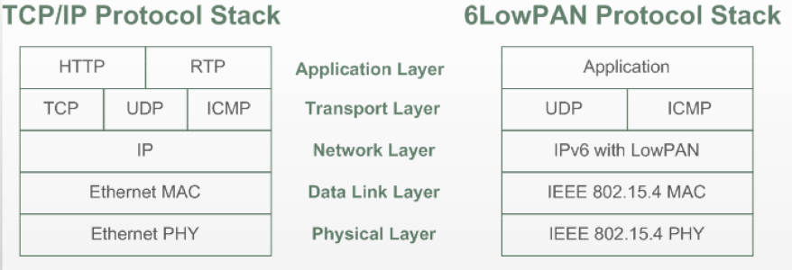

Slide 4
Benefits of using IP:
IP based devices connect easily to other IP networks
IP networks allow the use of existing infrastructure
IP based technologies have existed for decades
IP technology is specified in an open and freeway with standard process and documents
Tools for managing, commissioning and diagnosing IP based networks already exist

Slide 5
IP Demands:
Security
Web services
Management
Frame size

Slide 6
Demands of Wireless Embedded Devices and Networks:
Power and Duty Cycle : Low duty cycles preferred
Multicast : Wireless embedded radio technologies, such as IEEE 802.15.4 does not support multicast.
Mesh Topologies : To achieve coverage and cost efficiency.
Link Layer Mesh or Mesh Under routing
LoWPAN Mesh or IP routing
Bandwidth and frame size : Bandwidth – 20-250kbps and frame size – 40-200 bytes
Reliability : Standard IPs are not optimized for low power wireless networks.

Slide 7
What is 6LoWPAN?
Definition: 6LoWPAN standard enables the efficient use of IPv6 over low power, low rate wireless networks on simple embedded devices through an adaptation layer and optimization of related protocols.
Defined by IETF standards: RFC 4919,4944

Slide 8
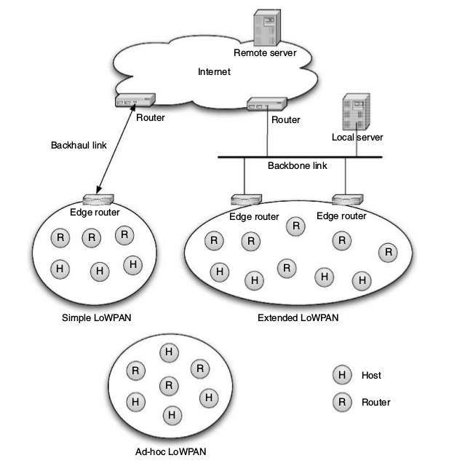
6LoWPAN Architecture:

Slide 9
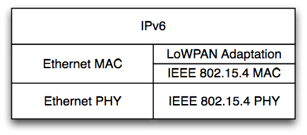
Architecture
LoWPANs are stub networks
Simple LoWPAN
Single Edge Router
Extended LoWPAN
Multiple Edge Routers with common backbone link
Ad-hoc LoWPAN
No route outside the LoWPAN
Internet Integration issues
Maximum transmission unit
Application protocols
IPv4 interconnectivity
Firewalls and NATs
Security
IPv6-LoWPAN Router Stack
Notes:
See Book Section 1.3 for a compact introduction.

Slide 10
Key Points:
6LoWPAN uses UDP
Adaptation between full IPv6 and LoWPAN is done by edge routers of 6LoWPAN islands.
IEEE 802.15.4 standard is the most common 2.4 Ghz wireless technology for embedded wireless applications.
6LoWPAN is designed to work with special type of link and has its own set of link requirements.
Framing,unicast transmission,addressing.

Slide 11
Addressing:
IEEE 802.15.4 standard supports unique EUI-64 addresses and configurable 16 bit short addressing.
Direct mapping between the link layer address and the IPv6 address is used for achieving compression.

Slide 12
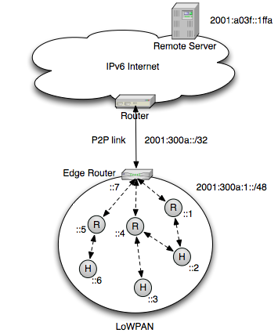

Slide 13
The 6LoWPAN Format:
Internet is composed of many IP subnetworks
“IP over X” specification for each type of subnetworks
Ex: IPv6 over Ethernet, IPv6 over IEEE 802.15.4

Slide 14
RECALL

Slide 15
IPv6 over IEEE 802.15.4 Challenges:
Fragmentation
- IPv6: Minimum MTU(Maximum Transmission Unit) is 1,280 bytes
- IEEE 802.15.4: Maximum 127 bytes
Head compression
- IPv6: 40 bytes compressed IP Header
- 802.15.4: effective link payload is 81 bytes
Routing
- IPv6: A link is a single broadcast domain
- 802.15.4: a mesh of short-range connections

Slide 16
The header overhead is large
802.15.4 maximum frame overhead of 25 bytes
Link-layer security can be as high as 21 bytes
This leaves 81 bytes left
40-byte IP header
8-byte UDP header
33 bytes remaining for actual data!

Slide 17
Functions of Adaptation Layer:
There are various problems to be addressed:
Links can be point-to-point or they can be multiple link
Finding path for packets to proceed to the next IP node:
– Lowpan is not connection oriented.
– Mesh-under routing, adaptation layer should provide L2 hop details and information for frame forwarding.

Slide 18
Functions of Adaptation Layer:
IP packets needs to be encapsulated in the subnetwork.
Some problems to be noted:
Different types of packets are carried by the links.
IP packets may not fit in L2 frame.
Lot of information in header.

Slide 19
Assumptions about link layer:
Link layer technologies beyond IEEE 802.15.4:
6LoWPAN is designed by keeping IEEE 802.15.4 in mind.
Goal is to make 6LoWPAN applicable to a much wider set of technologies.
Link layer service model:
Basic service requirements of 6LoWPAN on link layer:
One node needs to be able to send packets of limited size to another node within radio range.
IP is unreliable. Even 6LoWPAN knows that low power wireless links cannot always offer a high reliability.
6lowpan considers one hop neighborhood of a node.
IEEE 802.15.4 frame types: Data frame, Acknowledgement frames, MAC layer command frames (association, diassociation, synchronization..), Beacon frames.

Slide 20
Link Layer Addressing:
Link Layer address is not routable.
Data frames carry source and destination addresses.
IEEE 802.15.4 defines
• 64 bits address identified by EUI-64 (global/universal).
• 16 bits short address assigned by PAN coordinator.
• IEEE 802.15.4 identifies a node by PAN identifier and 16 bit short address.

Slide 21
Link Layer Management and operations:
6lowpan networks operates in beaconless mode.
Beacon based mode is also allowed.
MAC via unslotted CSMA/CA.
Security features with additional header.

Slide 22
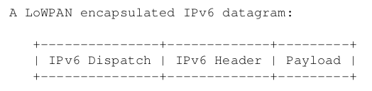
The Basic 6LoWPAN Format:
IEEE 802.15.4 packet format does not contain any fields to identify the payload that a packet is carrying.
The first byte of the payload indicates a dispatch byte.
Has type identifier and further information.

Slide 23
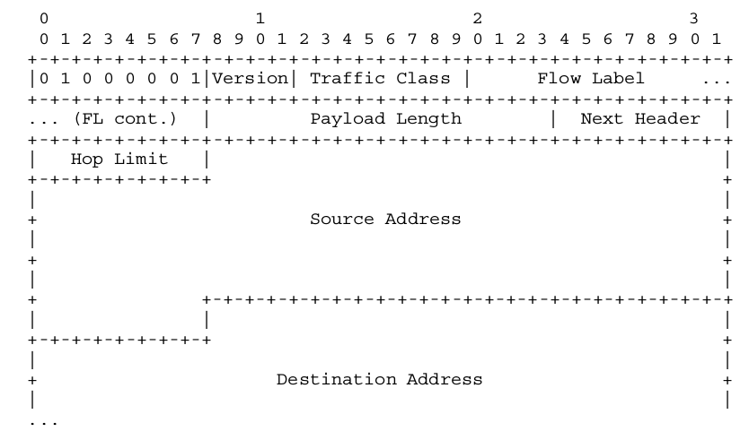

Slide 24
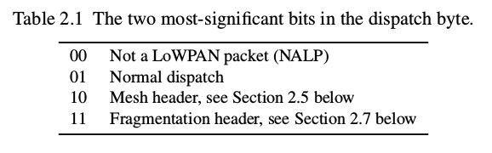

Slide 25
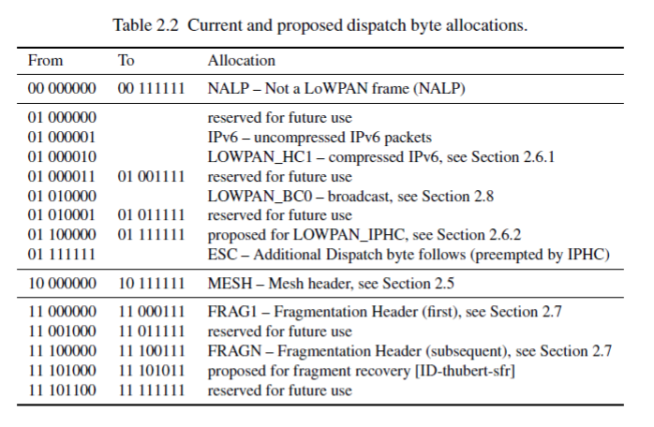

Slide 26
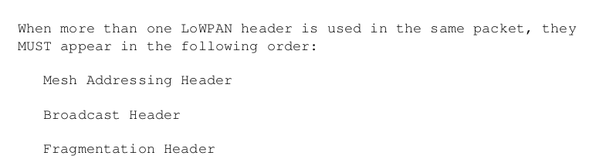

Slide 27
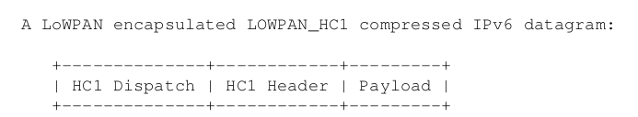

Slide 28
Addressing:
IP adaptation layer involves at least two kind of addresses.
– IP (L3) address: 128 bit IPv6 address
– Link layer (L2) address:
• 64 bit IEEE EUI - 64 address
• 16 bit short address assigned by PAN coordinator.

Slide 29
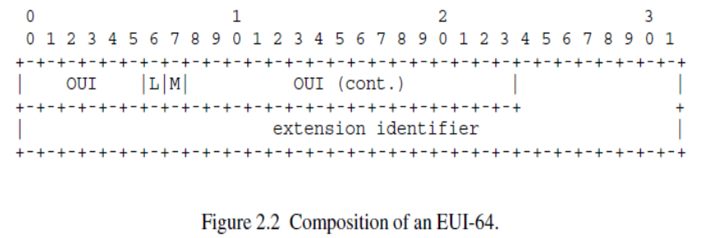
• EUI-64 address
– OUI: Organization Unique Identifier – 24 bits
– M: Muliticast address /Unicast address
– L: Locally assigned Address

Slide 30
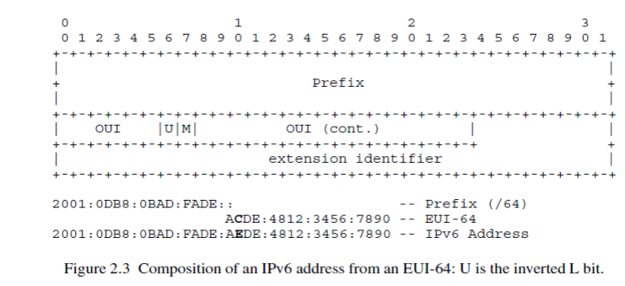

Slide 31
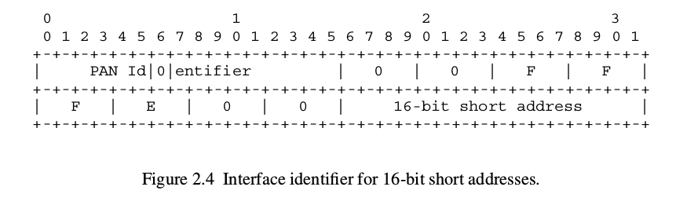
Short Address:
IPv6 Interface identifier for 16 bit short address 0X00FF and 0xFE00 are used. (reserved)

Slide 32
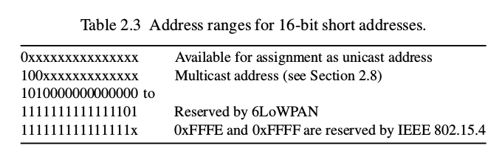

Slide 33
RECALL

Slide 34
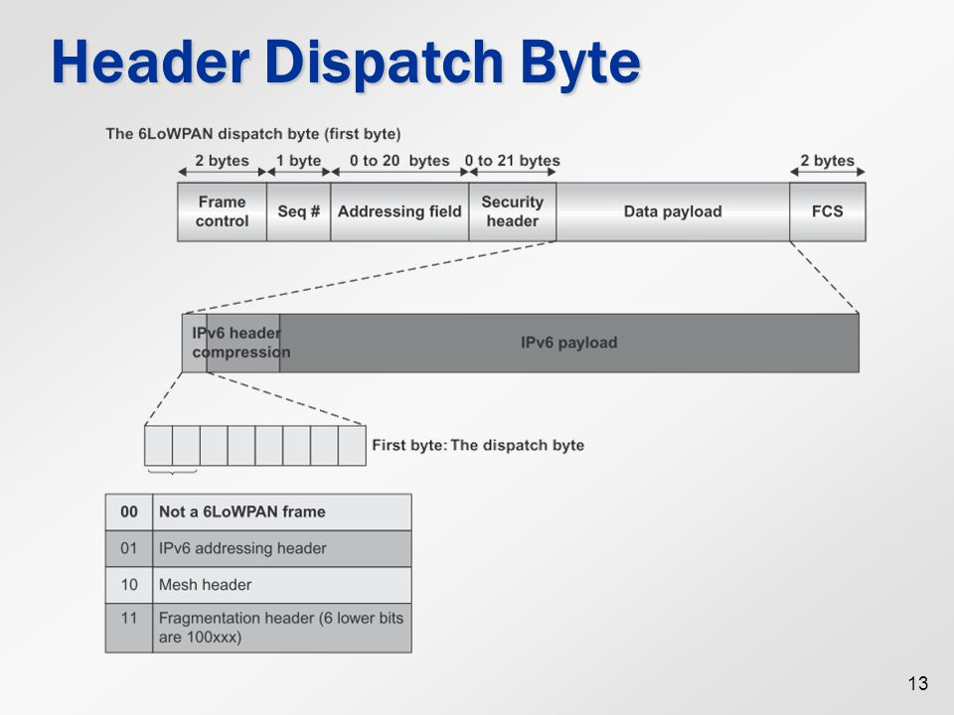

Slide 35
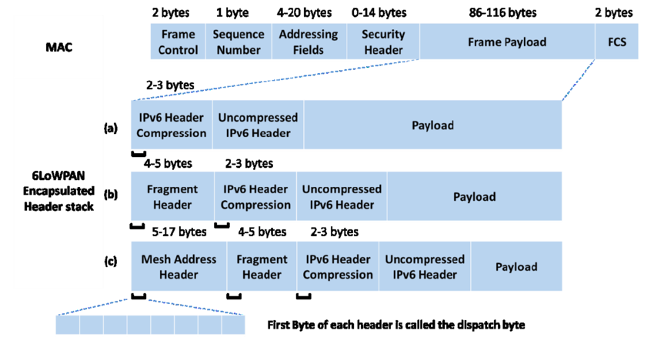

Slide 36
Forwarding and Routing :
Packets have to travel multiple hops on their way through the LoWPAN.
This involves two processes: Routing and Forwarding.
Both can be performed at Layer 2 or Layer 3.

Slide 37
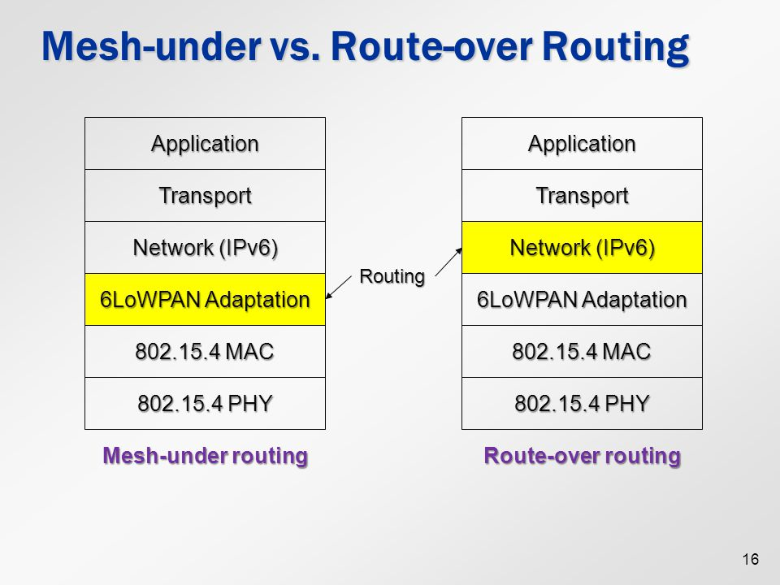

Slide 38
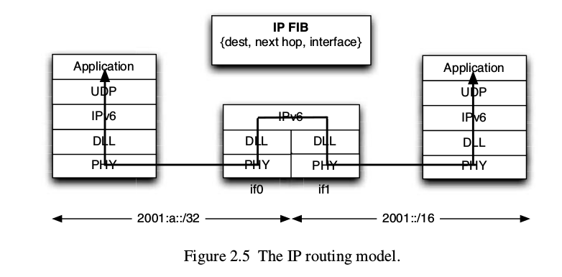

Slide 39
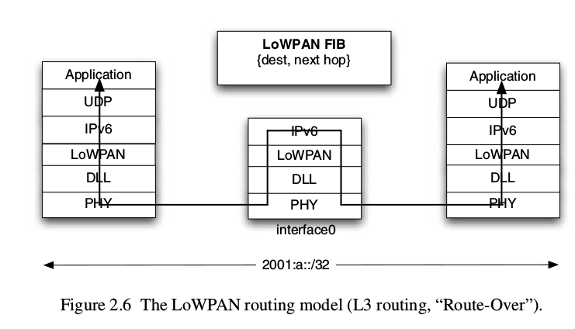

Slide 40
ROUTE OVER:
Routing at network layer
Uses IPv6 address
Each LoWPAN node acts as IP router
Each link layer hop is a IP hop
Uses IP header and routing table.
All fragments are reassembled by the adaptation layer and sent to the network layer.
If it is the final destination, packet is sent to transport layer
Else forward to the next hop based on routing table information.

Slide 41
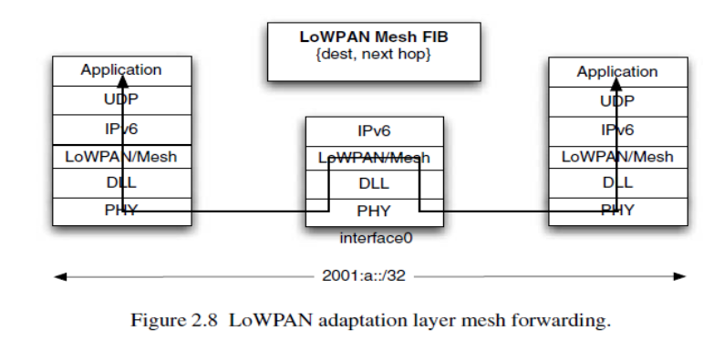

Slide 42
MESH UNDER:
Forwarding is done based on IEEE 802.15.4 frame
Uses MAC address, short address, EUI-64
Multiple link layer hops are used to complete one IP hop
At each hop, the link layer source and destination address is overwritten.
These information is useful for various operations. Ex: Reassembly.
So the 6LoWPAN defines Mesh Header.
It has hop limit too.
Mesh Header must be the first header in 6LoWPAN header stack.

Slide 44
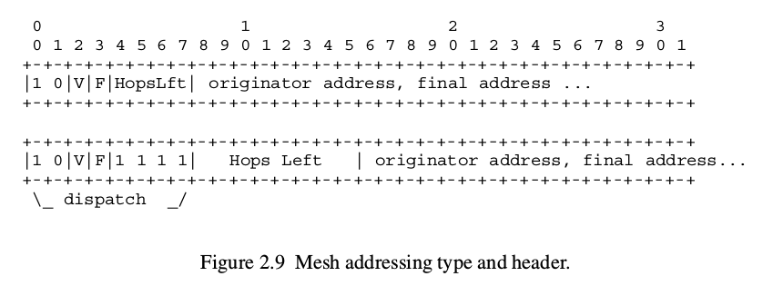

Slide 45
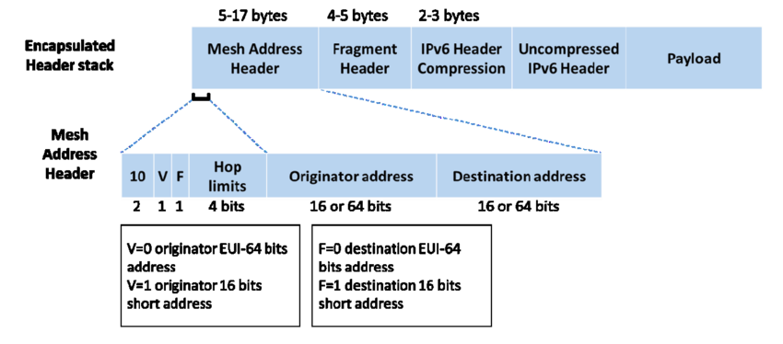

Slide 46
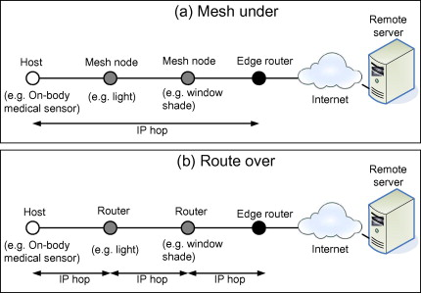

Slide 47
HEADER COMPRESSION
The cost of battery lifetime and channel capacity are main reason for header compression.
Redundant information can be removed.
Data compression may lead to packet lost and destroying of information.
Data compression algorithm are best suited for application layer contents.
Header compression can be end-to end or hop by hop.

Slide 48
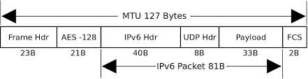
IEEE 802.15.4 MTU:

Slide 49
HEADER COMPRESSION
In short header compression improves network transmission efficiency, quality and speed with:
Decrease in packet header overhead (bandwidth savings)
Reduction in packet loss.
Better interactive response time.
Decrease in infrastructure cost, more users per channel bandwidth means less infrastructure deployment costs.

Slide 50
The process of header compression uses the concept of flow context.
It is the collection of information about field values and change patterns.
The header compression is hop by hop and not applied end to end.
At each hop in the IP network, it becomes necessary to decompress the packet to perform operations like QoS.

Slide 51
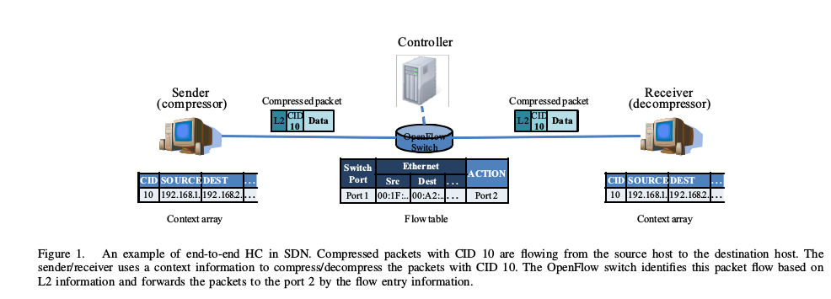
END TO END HEADER COMPRESSION:
“End-to-End Header Compression over Software-Defined Networks: a Low Latency Network Architecture”, Supalerk Jivorasetkul, Masayoshi Shimamura,,Katsuyoshi Iida, ICINCS, 2012

Slide 52
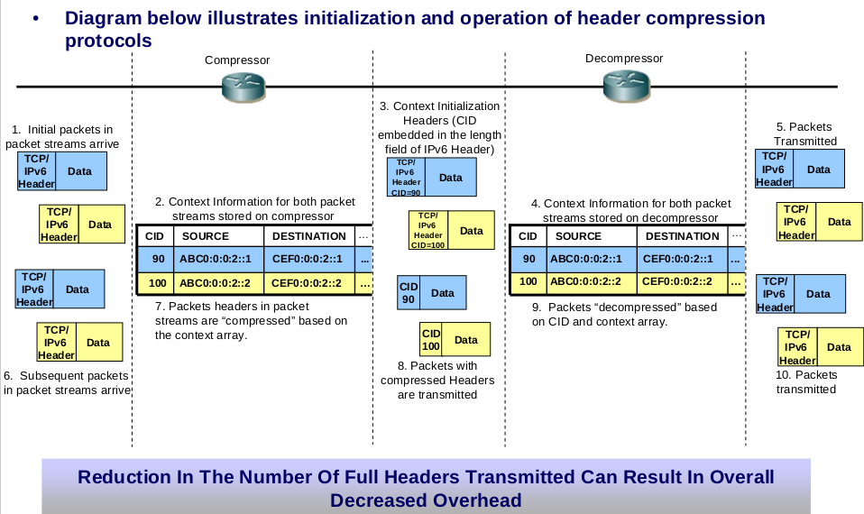

Slide 53
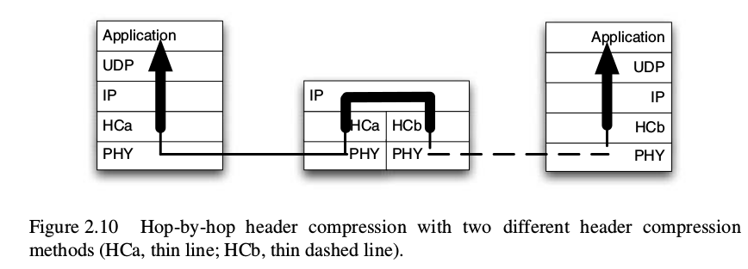

Slide 54
HEADER COMPRESSION
6LoWPAN employs
Stateless compression
Context based Header Compression
Stateless means no requirement for previous agreement between nodes exchanging the compressed packets.

Slide 55
Stateless Header Compression:
It is a flow independent compression
HC1 and HC2 Compression
HC1: Compression of IPv6 header
HC2: Compression of UDP header
HC1: dispatch value: 01000010

Slide 57
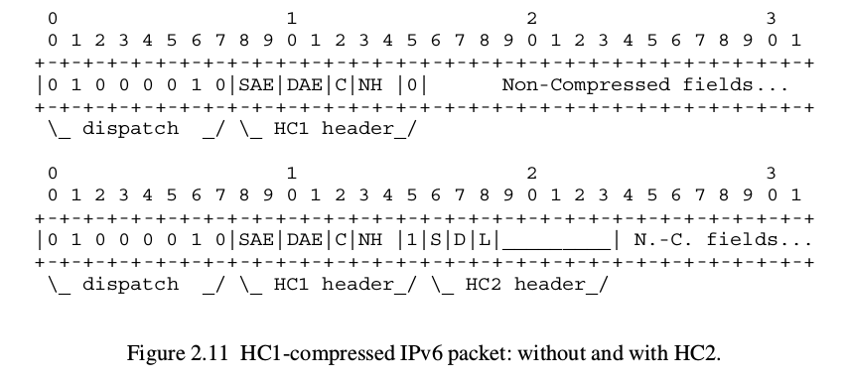

Slide 58
The version number is obviously always 6 and therefore never needs to be sent.
Two fields that often are zero in IPv6 headers are the traffic class and the flow label. The C bit in the HC1 header, if set, indicates that these bits indeed are zero and are not sent. If the C bit is clear, they are included among the non-compressed fields.
The payload length can be inferred from the remaining length of the 6LoWPAN PDU (which in turn can be found out from the link-layer frame or from the fragmentation mechanism) and therefore is never sent in a compressed header.
The next header field is one full byte, but has a number of values that are much more likely than others. The NH bits in the HC1 header, if non-zero, indicate that the next header field is implied by their value.
Finally, the Hop Limit was considered to be too difficult to compress and therefore is always sent in-line in the non-compressed fields.

Slide 59
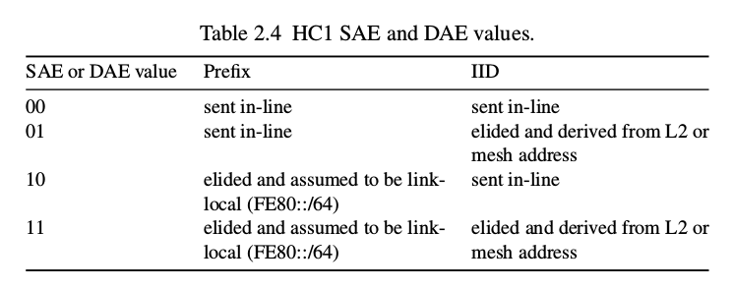

Slide 60
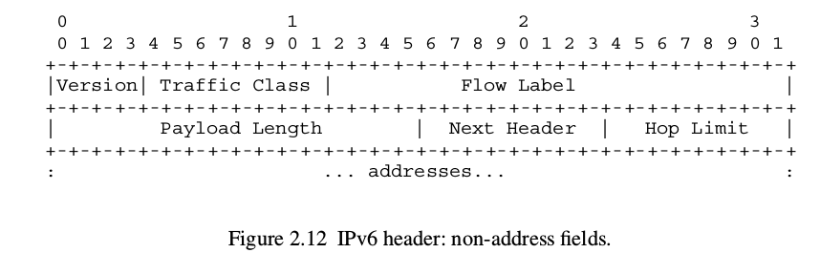

Slide 61
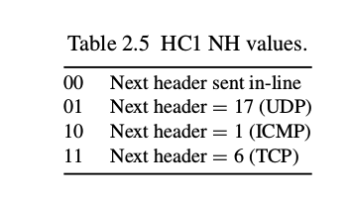

Slide 62
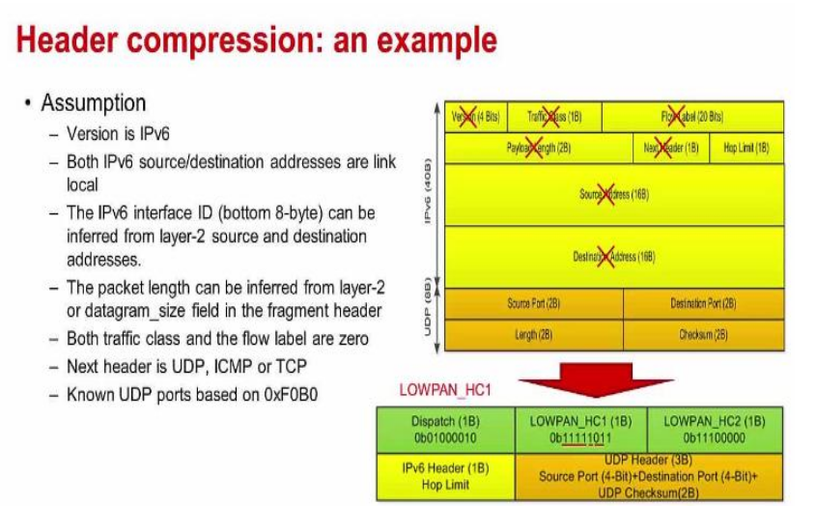

Slide 63
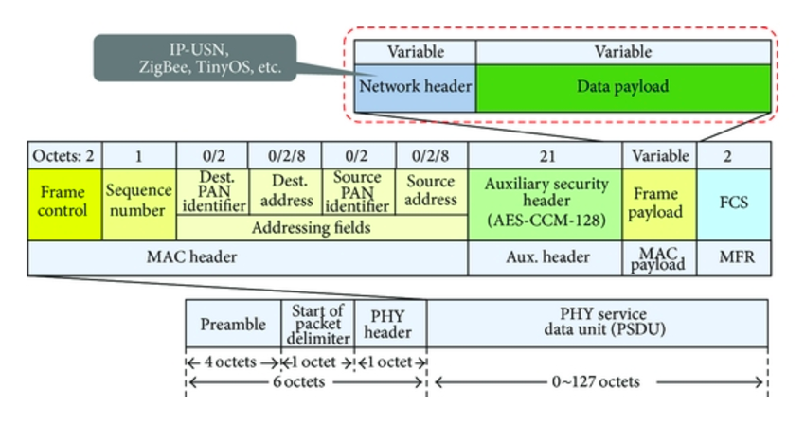
IEEE 802.15.4 Frame:

Slide 64
RECALL
HC2 Header Compression

Slide 65
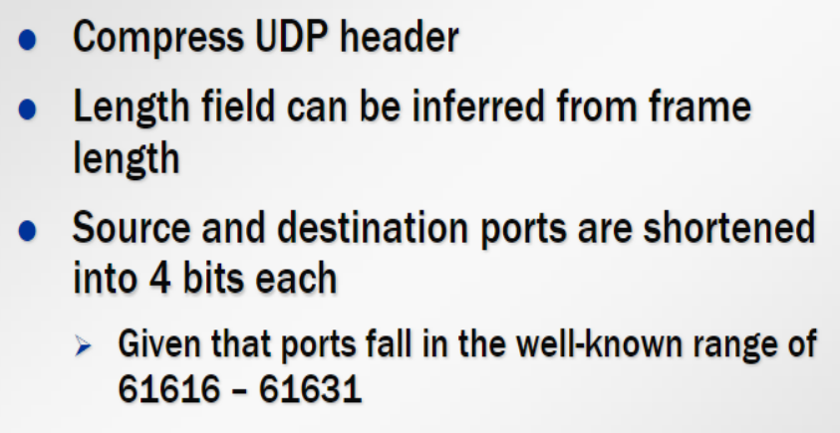
HC2 COMPRESSION
HC2 Header Compression

Slide 67
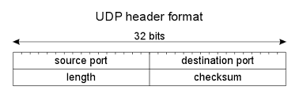
UDP HEADER:

Slide 68
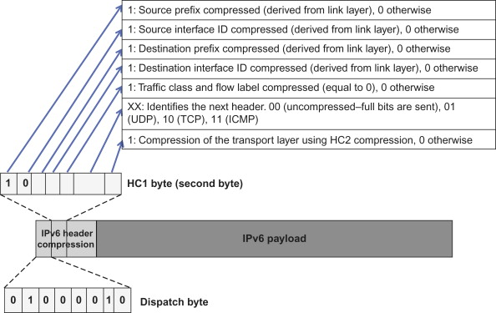

Slide 69
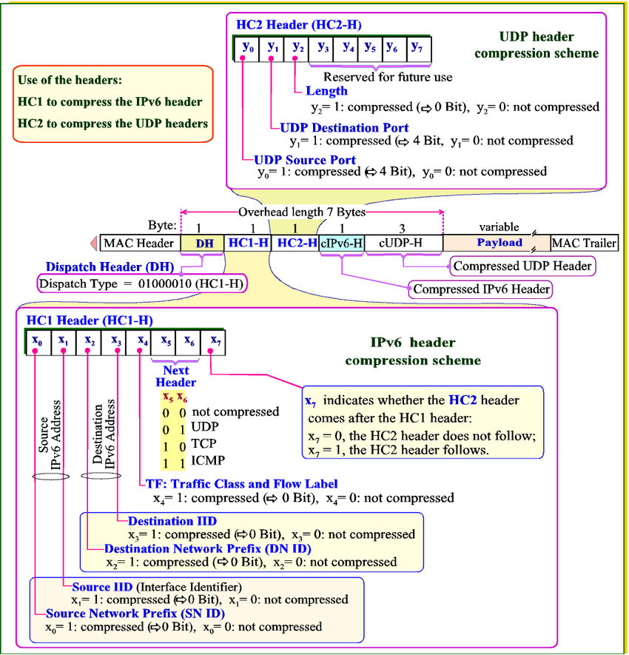

Slide 70
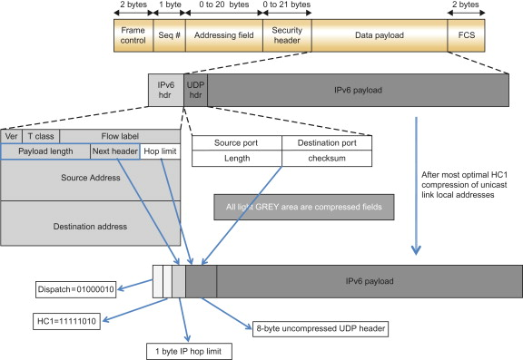

Slide 71
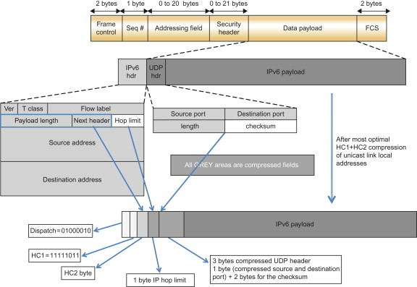

Slide 72
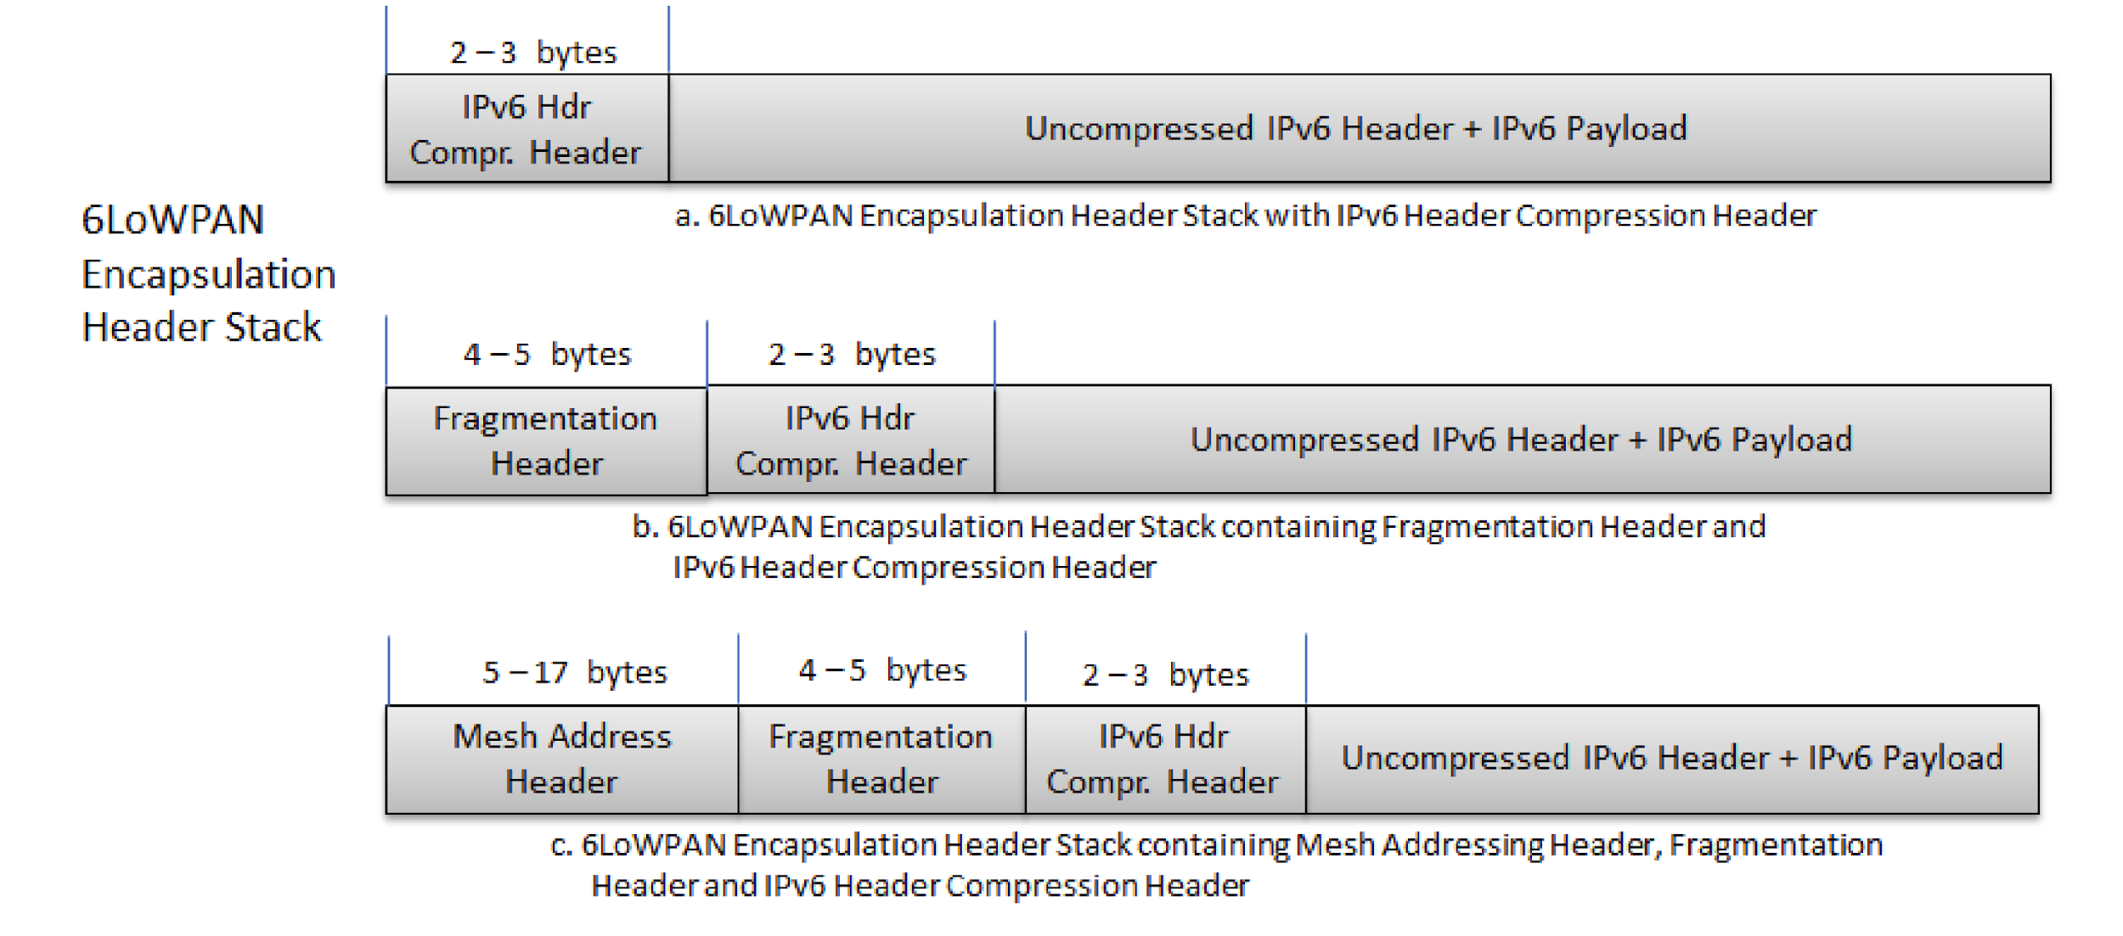

Slide 73
Lets Solve this:
Given :
PAN ID: 8456
Node ID : 0009
Prefix : 2001:0DB8:AC10:FE01
Find the 128 bit IPv6 address

Slide 74
Answer:
2001:0DB8:AC10:FE01:8456:00FF:FE00:0009

Slide 75
Lets Solve this:
Consider Source MAC address : E8-11-32-4E-07-DB, L2 Destination MAC address : A8-12-23-4A-08-AA
A source node sends an IPv6 packet to a destination in Link Local scope. As we know that one of the functionalities of 6LoWPAN is to compress the Headers from upper layer, it encodes its compression data as follows:
01000010 11111000 Followed by uncompressed data
What is the size of IPv6 header?
What is the IPv6 source and destination address?

Slide 76
Lets Solve this:
Consider the following Header compression encoding:
01000010 11111011 11100000 Followed by uncompressed data
What is the total Header size?

Slide 77
Lets Solve this:
6LoWPAN supports Mesh Under Routing. It makes use of Mesh Header to support this functionality. Analyze the 6LoWPAN Header encoding given below:
10111111 0009 0008 01000010 11111011 11100000 non- compressed fields

Slide 79
Lets Solve this:
Given network prefix : 2001:0DB8:AC10:FE01
Source MAC address : E8-11-32-4E-07-DB, L2 Destination MAC address : A8-12-23-4A-08-AA
Apply HC1 on the IPv6 packet.
What is the size of Header?

Slide 80
FRAGMENTATION AND REASSEMBLY

Slide 81
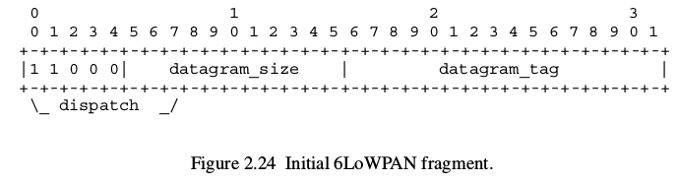

Slide 82
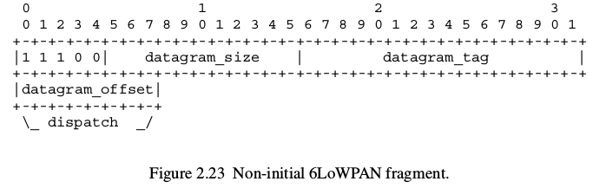

Slide 83
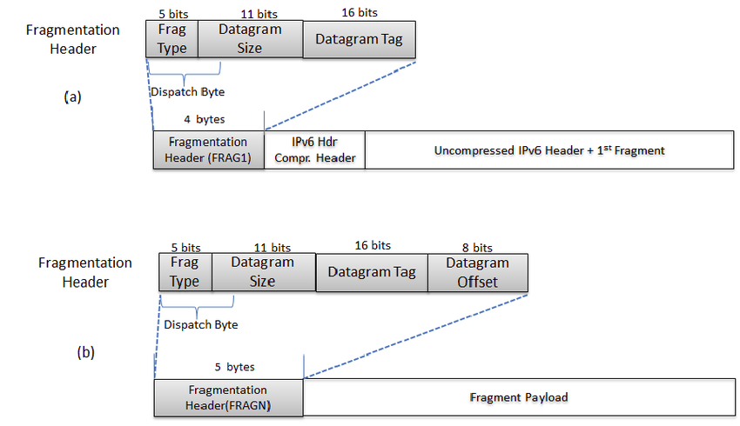

Slide 84
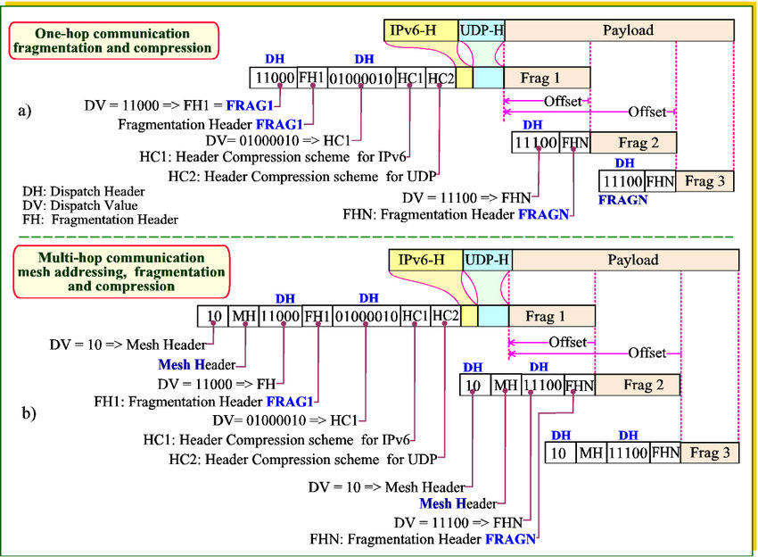

Slide 85
EXAMPLE:
10111111 0009 0008 11000 11111111111 0000000000000001 01000010 11111011 11100000 Frag1
10111111 0009 0008 11100 11111111111 0000000000000001 00100000 Fragment n

Slide 86
10111111 0009 0008 11000 11111111111 0000000000000001 01000010 11111011 11100000 Frag1
10111111 0009 0008 11100 11111111111 0000000000000001 00100000 Fragment n

Slide 87
CONTEXT BASED HEADER COMPRESSION:
Drawbacks of HC1 and HC2 :
Insufficient for most practical uses of IPv6 in 6LoWPAN.
HC1 is most effective for link – local unicast communication.
Link local address are commonly used for local protocol interactions such as IPv6 Neighbour Discovery, DHCPv6 or Routing protocols.
They are not used for application layer traffic.
Routable addresses must be used for communication with devices that are outside 6LoWPAN OR when IP routing is used within 6LoWPAN.
For Routable addresses, HC1 requires source and destination address prefix to be carried in-line.
When destination is multicast address, HC1 requires full 128-bit address to be carried in-line.

Slide 88
LoWPAN_IPHC : encoding format for effective compression of Local, Global and multicast IPv6 addresses.
It also allows compression of some commonly used Hop Limit values.
LoWPAN_NHC : encoding format for arbitrary next headers

Slide 89
ASSUMPTIONS MADE BY LoWPAN_IPHC:
Version 6, Traffic class and flow label are set to zero
Payload length can be inferred from lower layers from either the fragmentation header or the IEEE 802.15.4 header.
Hop Limit will be set to a well known value by the source.
Addresses assigned to 6LoWPAN interfaces will be informed using the link local prefix or a small set of routable prefixes assigned to the entire 6LoWPAN.
Addresses assigned to 6LoWPAN interfaces are formed with an IID derived directly from either 64-bit extended or 16-bit short addresses.

Slide 90
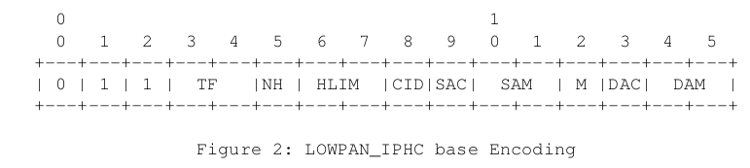
LOWPAN_IPHC Base Format:

Slide 91
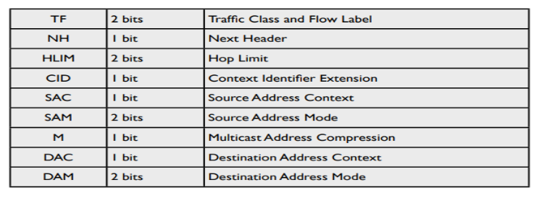

Slide 92
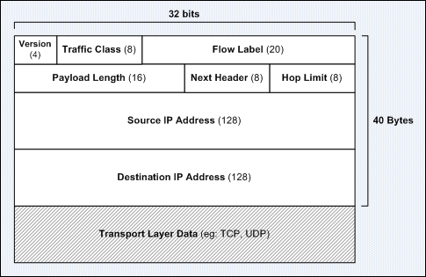
IPv6 Packet Format: (Recall)

Slide 93
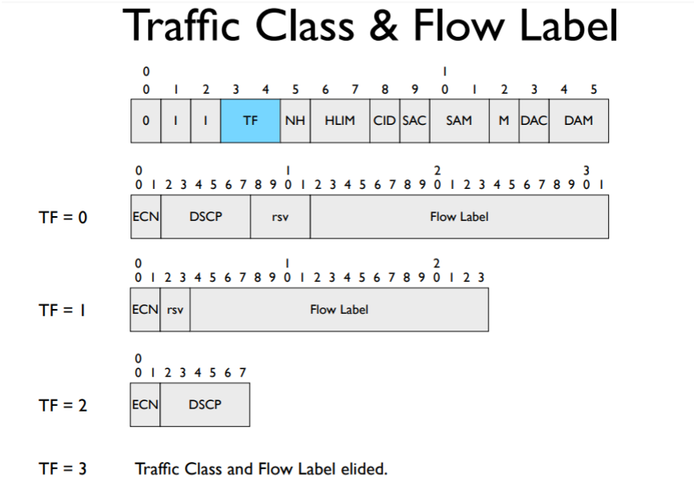

Slide 94
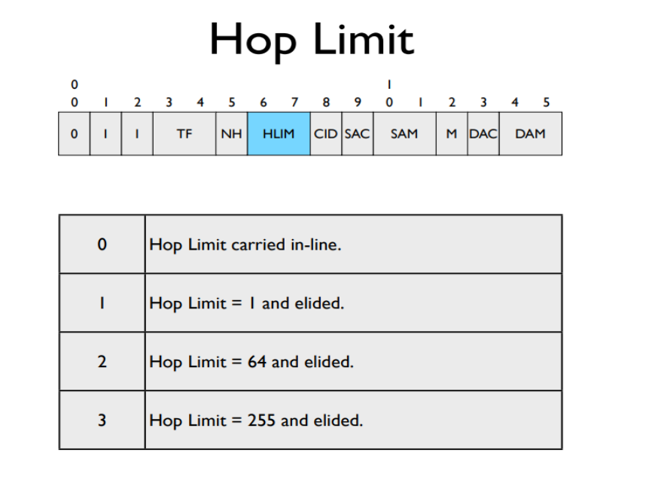

Slide 95
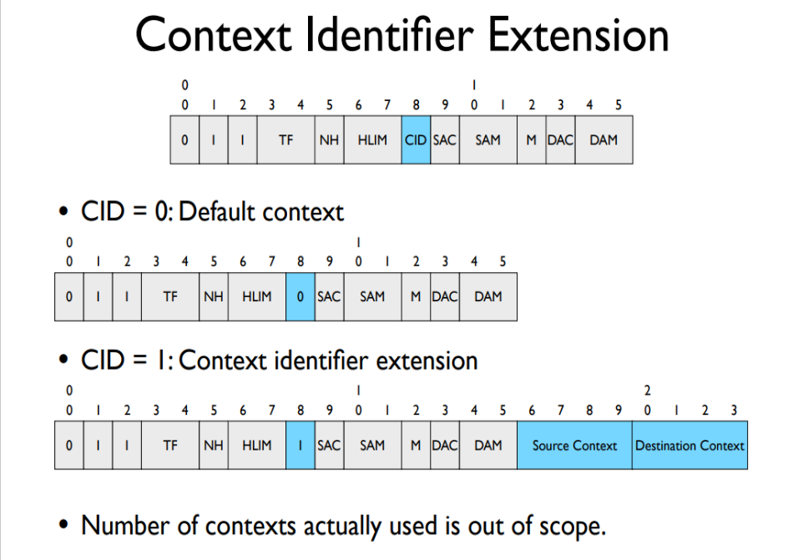

Slide 96


Slide 97


Slide 98


Slide 99

FFXX::00XX:XXXX
FF0X::0XXX

Slide 100


Slide 101

IPv6 Multicast Address: Prefix FF00::/8

Slide 102


Slide 103

LoWPAN_NHC:

Slide 104


Slide 105


Slide 106


Slide 107


Slide 108


